Slide 1

DEPARTMENT OF ARTIFICIAL INTELLIGENCE AND MACHINE LEARNING
AGB1303 – AI PROBLEM SOLVING TECHNIQUES
Batch - 09
Presented by :
            2303811714822041 - SAMEEHA J
            2303811714821049 - SUDHARSON S R
            2303811714822054 - VETHAABINAYA S
            2303811714821058 - VIMAL AANANTH B R
Guided by :
Mr. R. ROSHAN JOSHUA M.E.,(Ph.D.)
Assistant Professor (SS / Department of AI&DS )

Slide 2
PROJECT TITLE
AI-Based Medical Diagnosis Assistant Using Hybrid
Rule-Based and Case-Based Reasoning

Slide 3
RESEARCH OBJECTIVE
A unified medical diagnosis system that integrates rule-based reasoning (expert rules), case-based reasoning (historical patient cases), and probabilistic inference using Naïve Bayes to deliver accurate, reliable, and explainable disease predictions.

Slide 4
RESEARCH QUESTIONS
How can Rule-Based Reasoning and Case-Based Reasoning be effectively combined for medical diagnosis?
What level of diagnostic accuracy can be achieved using a hybrid RBR - CBR system with Naïve Bayes inference?
Can the hybrid approach handle overlapping symptoms while maintaining interpretability and reliability?

Slide 5
SYNTHESIS
Medical diagnosis assistant using artificial intelligence
Integrates rule-based and case-based reasoning
Uses probability to manage diagnostic uncertainty
Uses Naïve Bayes to combine results and handle uncertainty
Improves accuracy over traditional systems

Slide 6
SUMMARIZE
This project provides both accuracy and interpretability in AI-based medical diagnosis. Existing approaches often rely only on rule-based logic, which lacks flexibility, or purely data-driven methods, which reduce explainability. By combining rule-based reasoning, case-based reasoning, and probabilistic inference using Naïve Bayes, the system delivers reliable disease prediction while clearly explaining how each diagnosis is made.

Slide 7
FRAMEWORK
P (Problem) : Doctors face difficulty in diagnosis due to overlapping symptoms.
I (Intervention) : Hybrid AI system using rule-based, case-based reasoning, and Naïve Bayes.
C (Comparison) : Traditional single-method or black-box diagnostic systems.
O (Outcome) : Accurate and explainable diagnosis support for doctors.

Slide 8
ABSTRACT
This project proposes an AI-based medical diagnosis assistant using a hybrid reasoning architecture. Patient symptoms are analyzed using RBR and matched with historical cases through CBR. A Naïve Bayes inference layer combines both outputs to handle uncertainty and improve diagnostic accuracy. The system provides explainable disease predictions to support doctors in clinical decision-making. The proposed approach achieves reliable and accurate diagnosis while maintaining transparency and adaptability.

Slide 9
EXSISTING SYSTEM
Medical diagnosis is often performed manually or using single-method AI systems.
These systems rely only on predefined rules or historical data, limiting flexibility and explainability.
Demerits:
• Rigid rule-based logic
• Poor handling of overlapping symptoms
• Limited explanation of diagnosis results

Slide 10
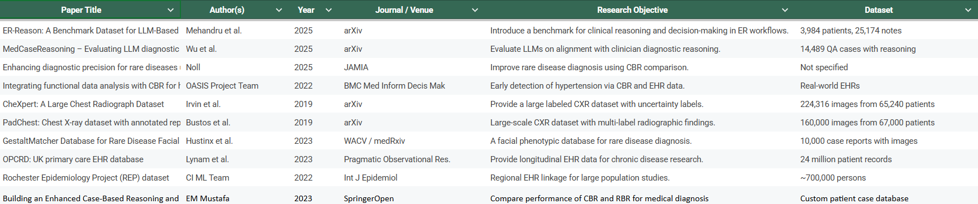
LITERATURE SURVEY
  Literature Survey Sheet Link

Slide 11
PROPOSED SYSTEM
Patient symptoms are analyzed using a hybrid AI diagnosis framework.
Combines Rule-Based Reasoning, Case-Based Reasoning, and Naïve Bayes inference to improve accuracy.
Merits:
• Accurate and reliable diagnosis
• Explainable clinical decision support
• Effective handling of overlapping symptoms

Slide 12
SYSTEM SPECIFICATION
HARDWARE SPECIFICATIONS
• Processor : Intel Core i5 / AMD Ryzen 7 with Minimum
4 cores @ 2.5 GHz
• RAM : 8 GB DDR4 (16 GB recommended)
• Storage : 256 GB SSD (512 GB recommended)
• Graphics : Integrated GPU or NVIDIA GTX 1650 (4 GB)
• Network : Standard Wi-Fi / Ethernet Connectivity

Slide 13
SOFTWARE SPECIFICATIONS
• Operating System : Windows 10/11 Pro (64-bit)
• Programming Language : Python 3.9+ with libraries: scikit-learn
(Naive Bayes), NumPy, Pandas, SciPy
• Rule Engine : Custom Python-based Rule Engine (IF–THEN rules)
• Database : CSV / JSON based storage for rule base & case library
(Optionally SQLite / MongoDB for structured storage)
• GUI Framework : Tkinter / Web-based UI (Flask optional)
• Development Tools : Jupyter Notebook, VS Code / PyCharm, Git.

Slide 14
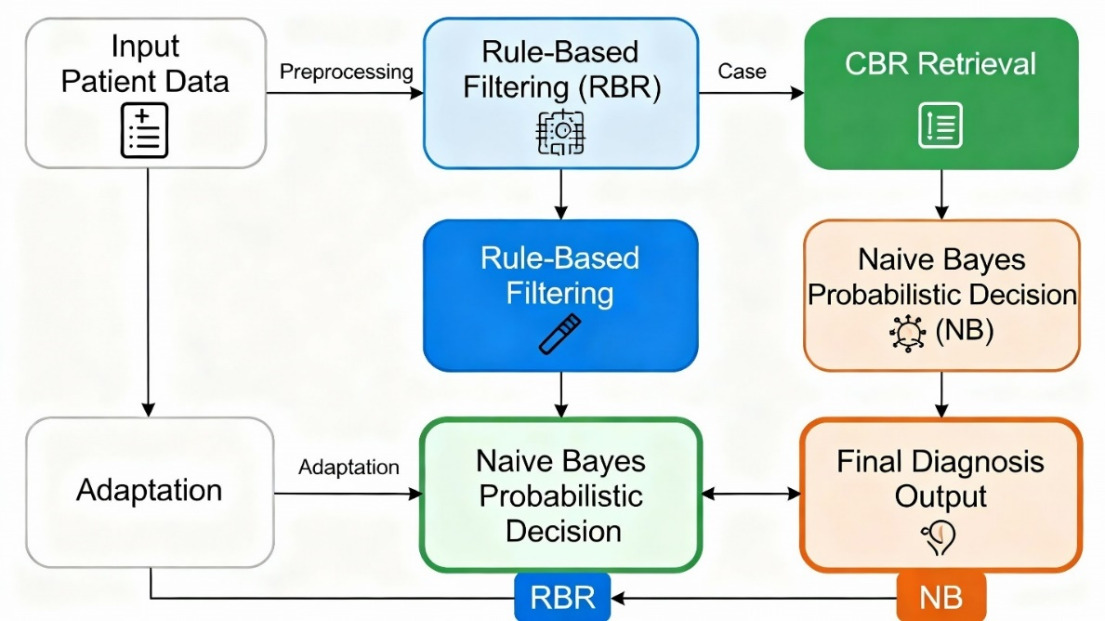
SYSTEM ARCHITECHTURE
Figure No. – 01 – System Architecture Diagram

Slide 15
RESEARCH METHODOLOGY
Rule based reasoning
Case based reasoning
Naïve bayes probabilistic method
Hybrid reasoning integration

Slide 16
METHODOLOGY
RULE-BASED REASONING (RBR)
Uses expert IF–THEN medical rules to quickly detect common disease patterns.
Applies forward chaining to match user symptoms with relevant diagnostic rules.
Provides high transparency by clearly showing which rule triggered the diagnosis. Offers a fast, reliable baseline but may struggle with ambiguous or incomplete data.

Slide 17
2. CASE-BASED REASONING (CBR)
Matches a new patient’s symptoms with similar past cases from a case library.
Uses feature vectors and similarity checks to find the closest historical cases.
Helps diagnose confusing or overlapping symptoms by learning from real examples.
Improves accuracy over time as more cases are collected and added.

Slide 18
3. NAÏVE BAYES PROBABILISTIC MODEL
Calculates how likely each disease is based on the given symptoms.
Uses a simple assumption that each symptom contributes independently.
Works well even when symptoms are missing or unclear.
Gives a list of diseases ranked by their probability for better decision-making.

Slide 19
4. HYBRID REASONING INTEGRATION
Combines RBR, CBR, and Naïve Bayes to give a stronger and more accurate final diagnosis.
Uses expert rules, past patient cases, and probability scores together for better decision-making.
Resolves conflicts between methods so no single approach misleads the diagnosis.
Improves overall accuracy, consistency, and confidence compared to using any one method alone.

Slide 20
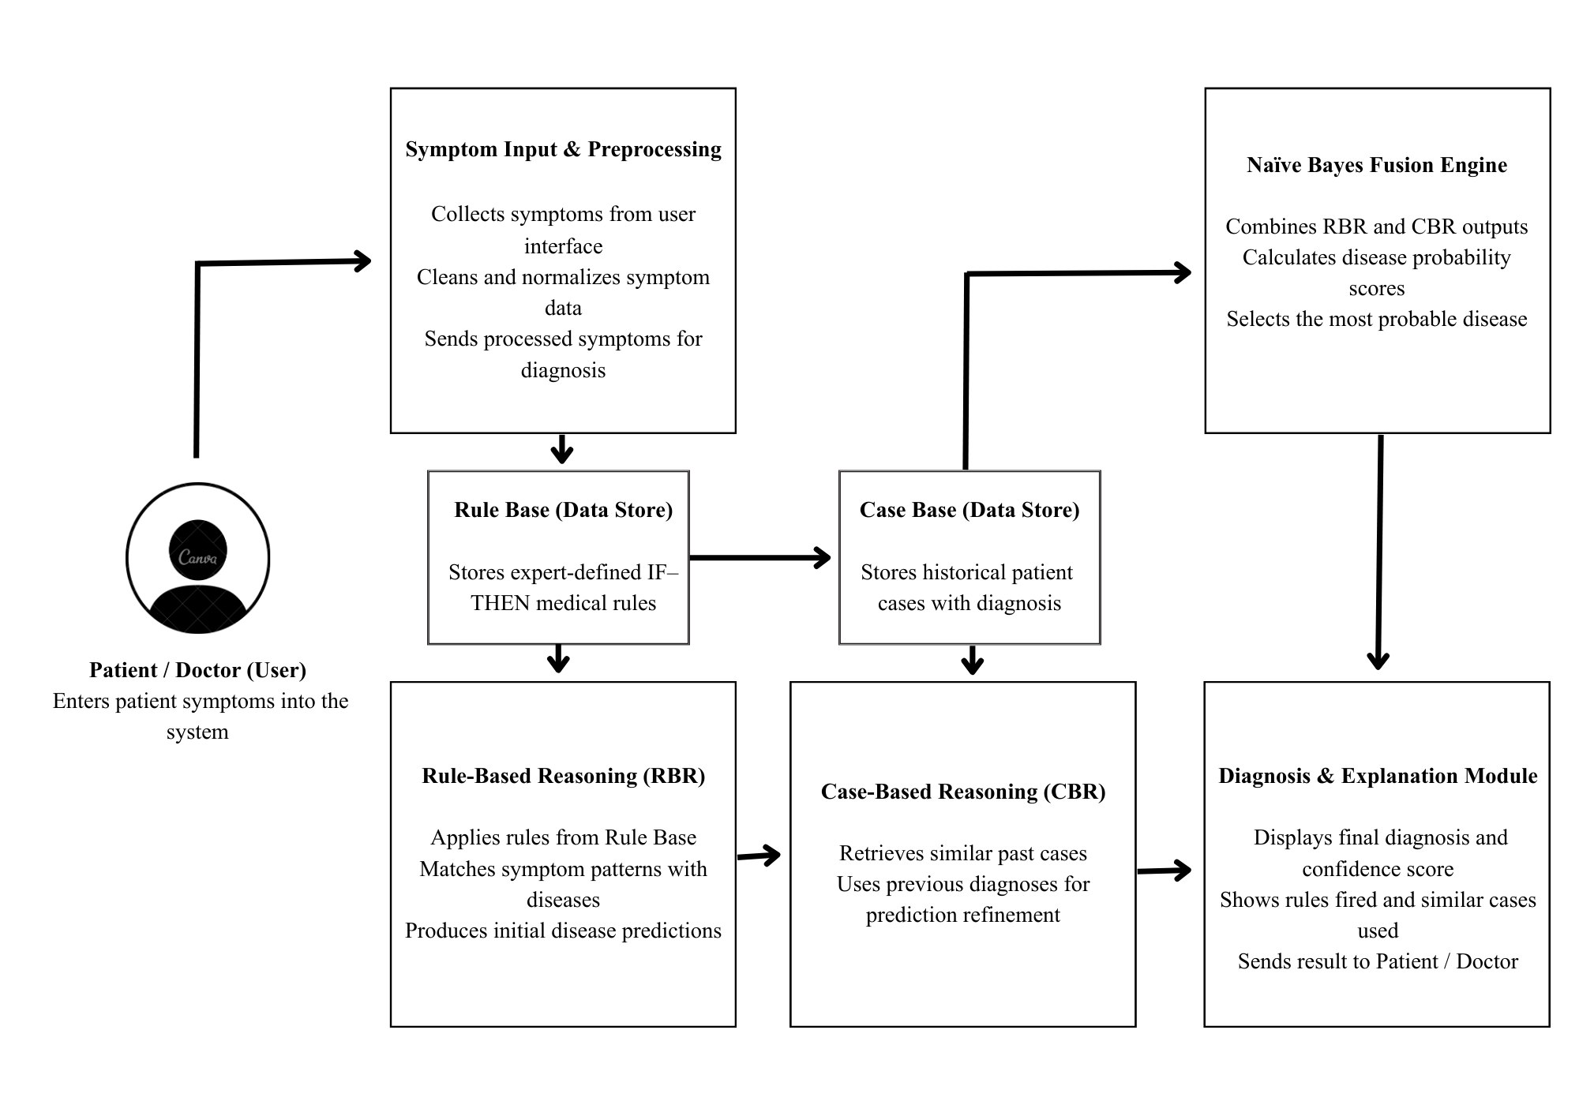
DATAFLOW DIAGRAM

Slide 21
MODULES
Symptom Processing Module
Expert Logic Evaluation Module
Clinical Case Matching Module
Probabilistic Assessment Module
Integrated Decision Synthesis Module
Diagnosis Reporting Module

Slide 22
MODULE 1: SYMPTOM PROCESSING MODULE
Cleans and standardizes symptoms so the system receives consistent and usable inputs.
Fixes spelling differences, formatting issues, and normalizes all symptom names.
Handles missing or unclear symptoms by asking for clarification or using safe defaults.
Ensures high-quality symptom data, reducing errors and improving the accuracy of all reasoning modules.

Slide 23
MODULE 2: EXPERT LOGIC EVALUATION MODULE
Uses expert IF–THEN medical rules to match symptoms with diseases.
Checks symptoms using forward chaining to find rule-based diagnoses.
Clearly explains which rule triggered each diagnosis for trust and transparency.
Gives fast, reliable, and clinically aligned results as the first diagnostic layer.

Slide 24
MODULE 3: CLINICAL CASE MATCHING MODULE
Matches new patient symptoms with similar past cases from a case library.
Converts symptoms into feature vectors and calculates similarity scores.
Helps diagnose confusing or overlapping symptoms using real patient examples.
Improves accuracy over time as more cases are added and learned from.

Slide 25
MODULE 4: PROBABILISTIC ASSESSMENT MODULE
Calculates how likely each disease is based on the given symptoms using probability.
Combines prior disease rates with symptom likelihoods to compute final probabilities.
Handles uncertainty and incomplete symptom data better than rule-based methods.
Ranks diseases by probability, adding clear confidence levels to the diagnosis.

Slide 26
MODULE 5: INTEGRATED DECISION SYNTHESIS MODULE
Combines outputs from rule-based, case-based, and probabilistic modules into one final diagnosis.
Uses weighting or confidence scoring to balance and merge the different results.
Resolves conflicts and removes duplicate or weak suggestions from individual modules. Produces a more accurate and reliable diagnosis than any single method alone.

Slide 27
MODULE 6:DIAGNOSIS REPORTING MODULE
Shows the final predicted disease along with its probability score.
Displays evidence like triggered rules and similar past cases for clarity.
Provides transparent explanations to help doctors trust the diagnosis.
Offers extra insights such as confidence levels and alternative diagnoses.

Slide 28
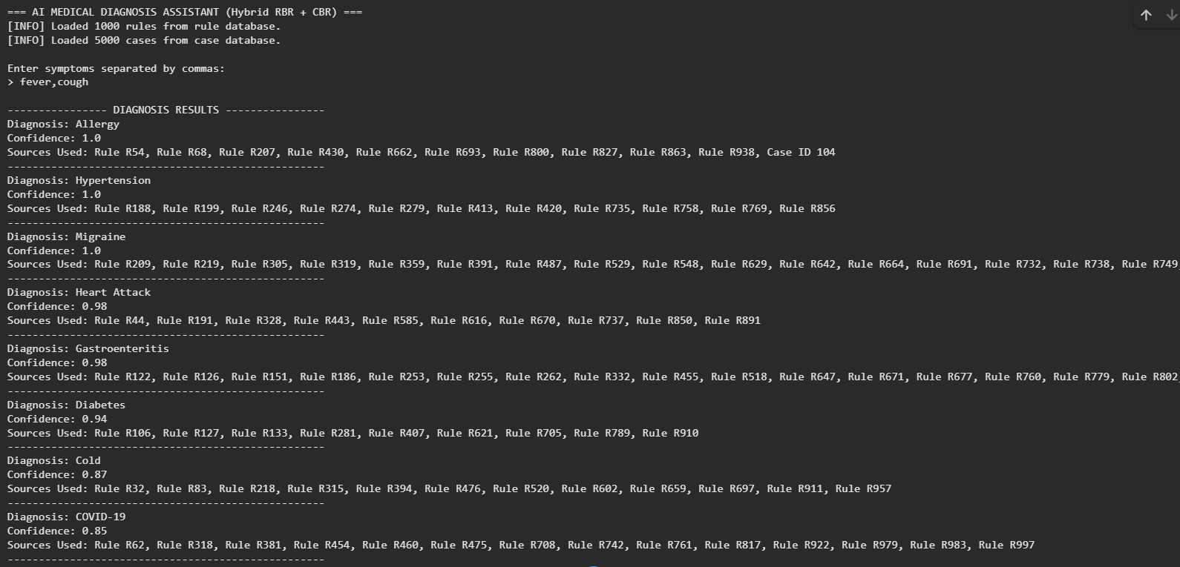
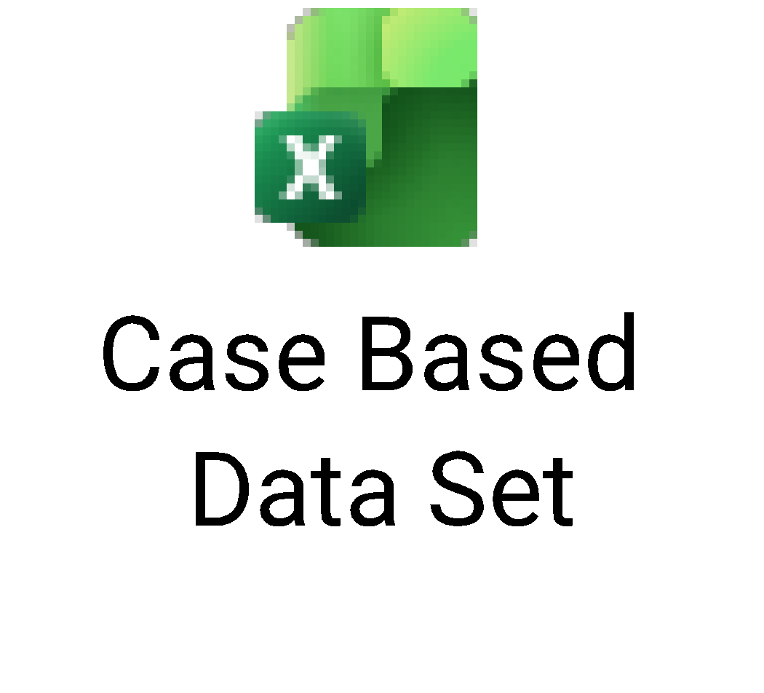
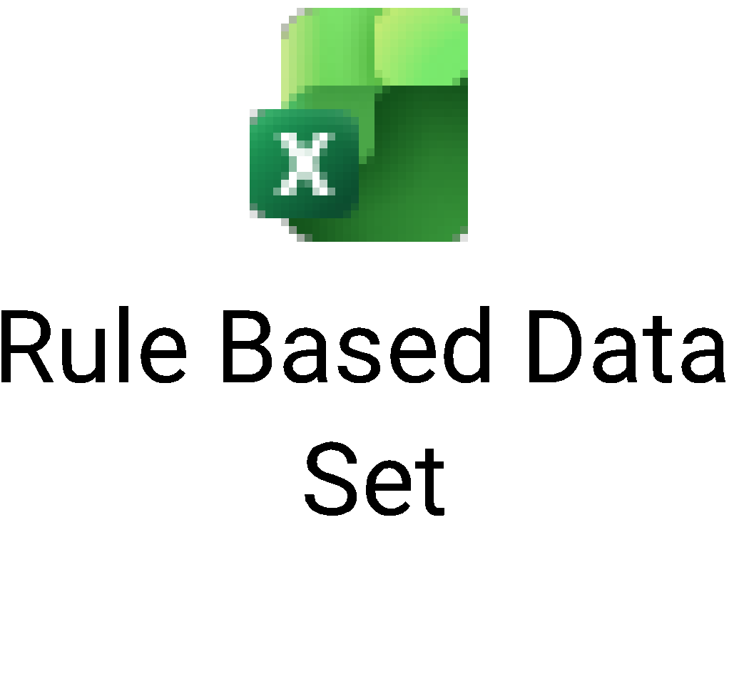
OUTPUT
Figure No. – 02 – Implementation & Datasets

Slide 29
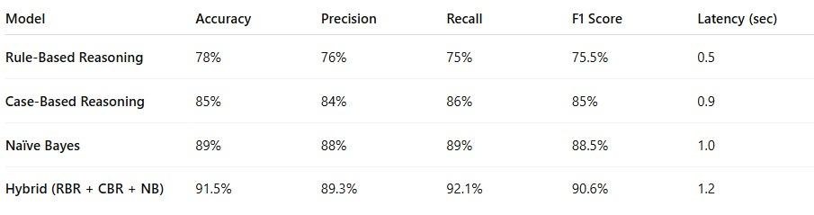
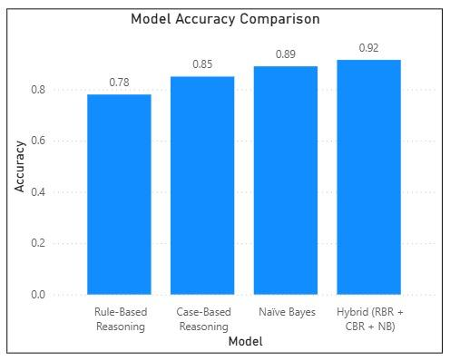

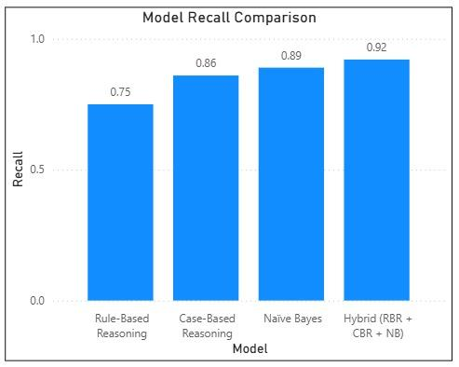
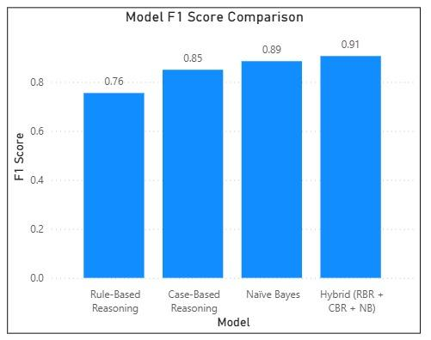
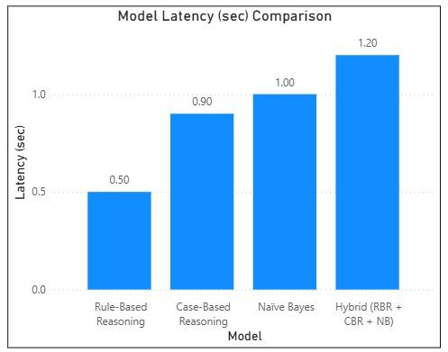
OUTPUT
Figure No. – 03 – Model Comparison Graphs & Tables

Slide 30
EVALUATION METRICS
Accuracy: Measures how correctly the system predicts diseases.
Precision: Shows how many predicted diseases are actually correct.
Recall (Sensitivity): Indicates how well real disease cases are detected.
F1 Score: Provides a balanced measure using precision & recall.
Response Time: Time taken by the system to produce a diagnosis.
Explainability: Ability to explain why a diagnosis was predicted.

Slide 31
Thank You

